Slide 1
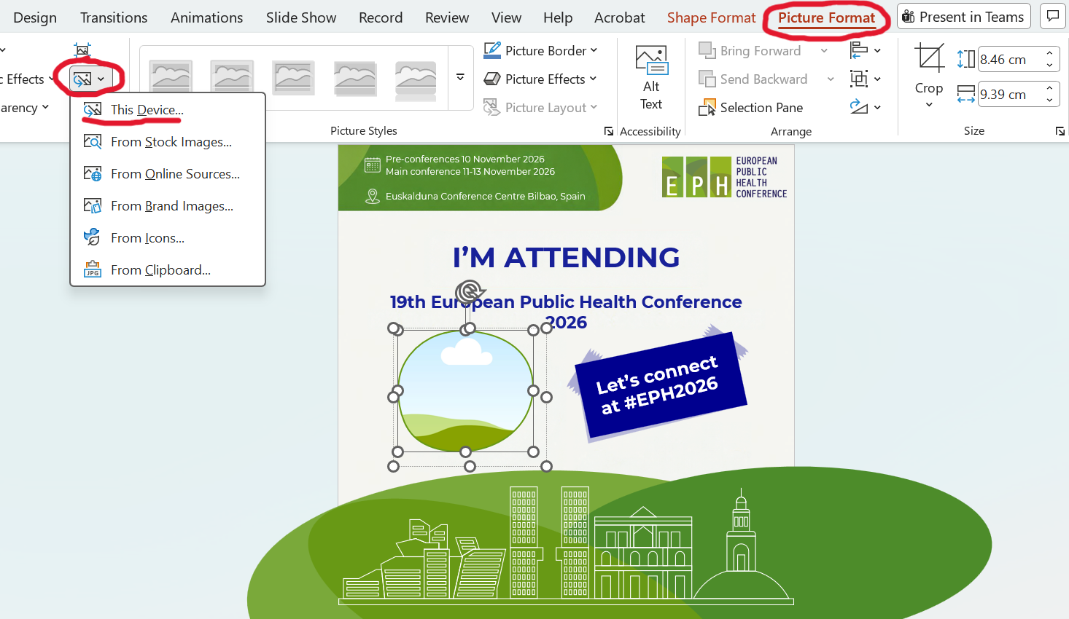
Instructions
Add your photo:
  Click on the frame twice (until you see two boxes).
  In the top menu, go to the tab “Picture Format”.
  On the top left, click on the icon that has an arrow on the image.
  Then click on “This Device”
  Choose your photo and insert it.

Slide 2
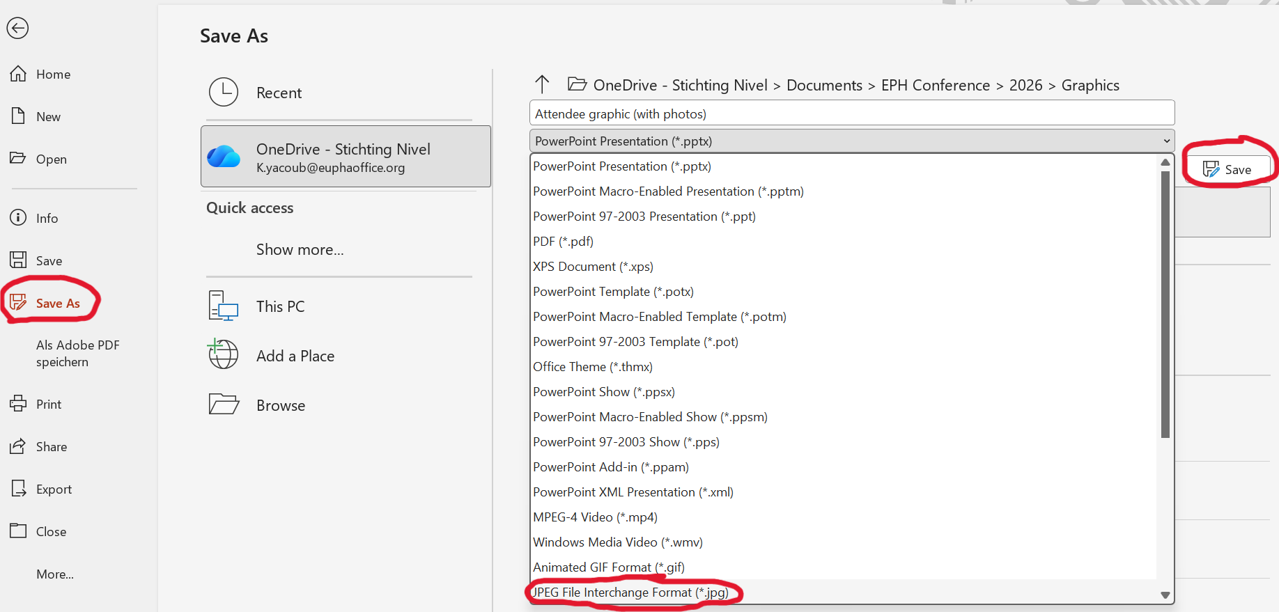
Instructions
Save as image (not PPT):
  Go to File – Save As
  In the document type options, choose “JPEG File Interchange Format”.
  Once you click on save it will then ask you if you want to save all slide or just this one. Choose the option you want.

Slide 3






Pre-conferences 10 November 2026
Main conference 11-13 November 2026
Euskalduna Conference Centre Bilbao, Spain
VIEW MY POSTER
19th European Public Health Conference 2026
Let’s connect at #EPH2026

